Slide 1
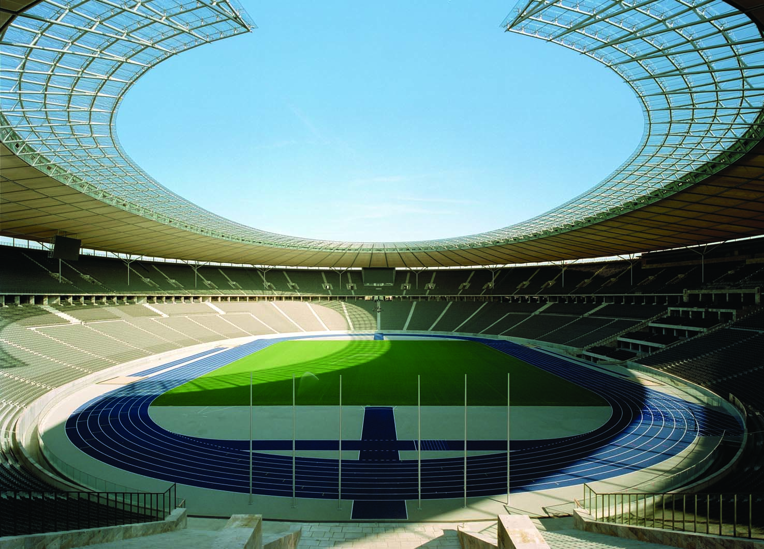
10
MONEY AND PRICES IN THE LONG RUN

Slide 2
29
The Monetary System

Slide 3

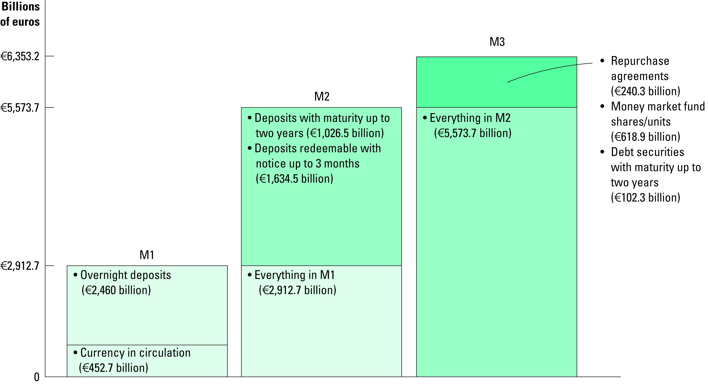
Figure 1 Three Measures of the Money Stock for the Euro Area
Copyright©2003 Southwestern/Thomson Learning

